Slide 1
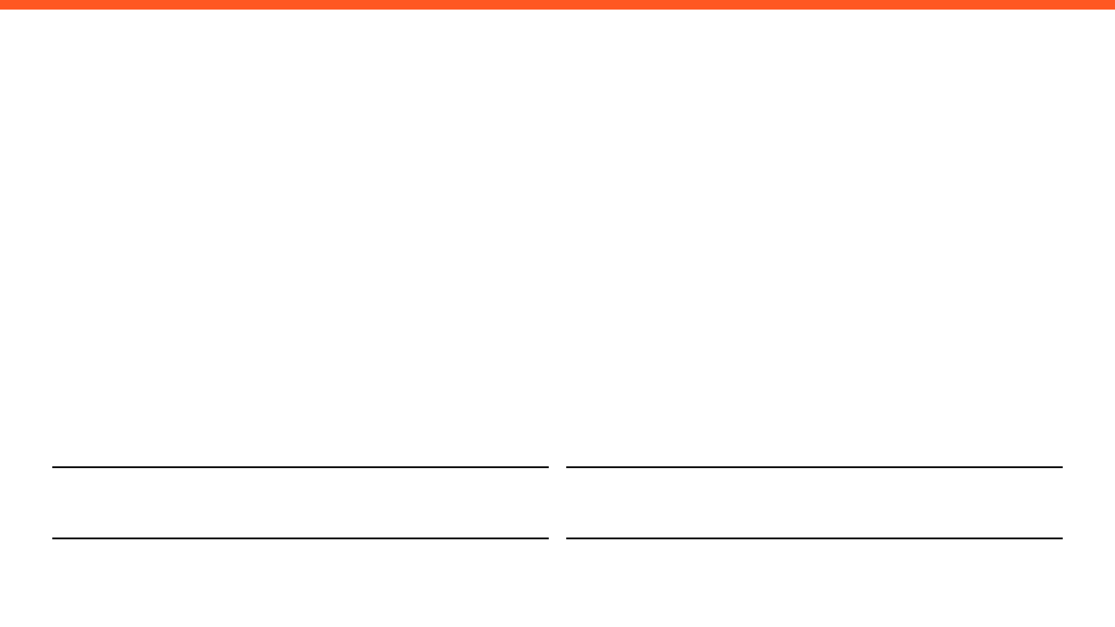
WEEKLY PROGRESS REPORT
Mechatronic System Design (MEC483) – Course Project
PROJECT / PHASE
DATE RANGE
Smart Pick and Place Robot
24/3/2026 – 31/3/2026
TEAM MEMBERS
Maher Abo Abed (1087993) , Sabeeha Zainab Hasham (1089042), Basel Feras Ghunaim (1088912), Ahmad Nasser Alshehhi (1090882)

Slide 2

HOW ARE WE DOING THIS WEEK?
TOP WINS (MAX 3)
KEY BLOCKERS / RISKS (MAX 3)
PROJECT HEALTH
Started the conceptual design phase, which includes design requirement, constraints ,sketches, and CAD models for the different systems (Platform, rotary joint, and prismatic joint)
Building a foundation for the electrical architecture (battery requirements, motor drivers, step down, cables, power unit)
Used the HSV colour detection system alongside shape detection using Opencv to identify an object within a test space.
Blocker : Limited university access, making gathering as a group extremely difficult.
Risk: The components are pricey, so every step has to be studied carefully before executing.
Blocker: Uncertainty around the future of the semester is creating hesitation and doubt.
Scope
Under Execution
Schedule
Potential Delays
Fabrication & Prototyping
On Halt
OPEN ISSUES
3 Active

Slide 3

Project Schedule (Gantt)
Agile Gantt chart1.xlsx​

Slide 4
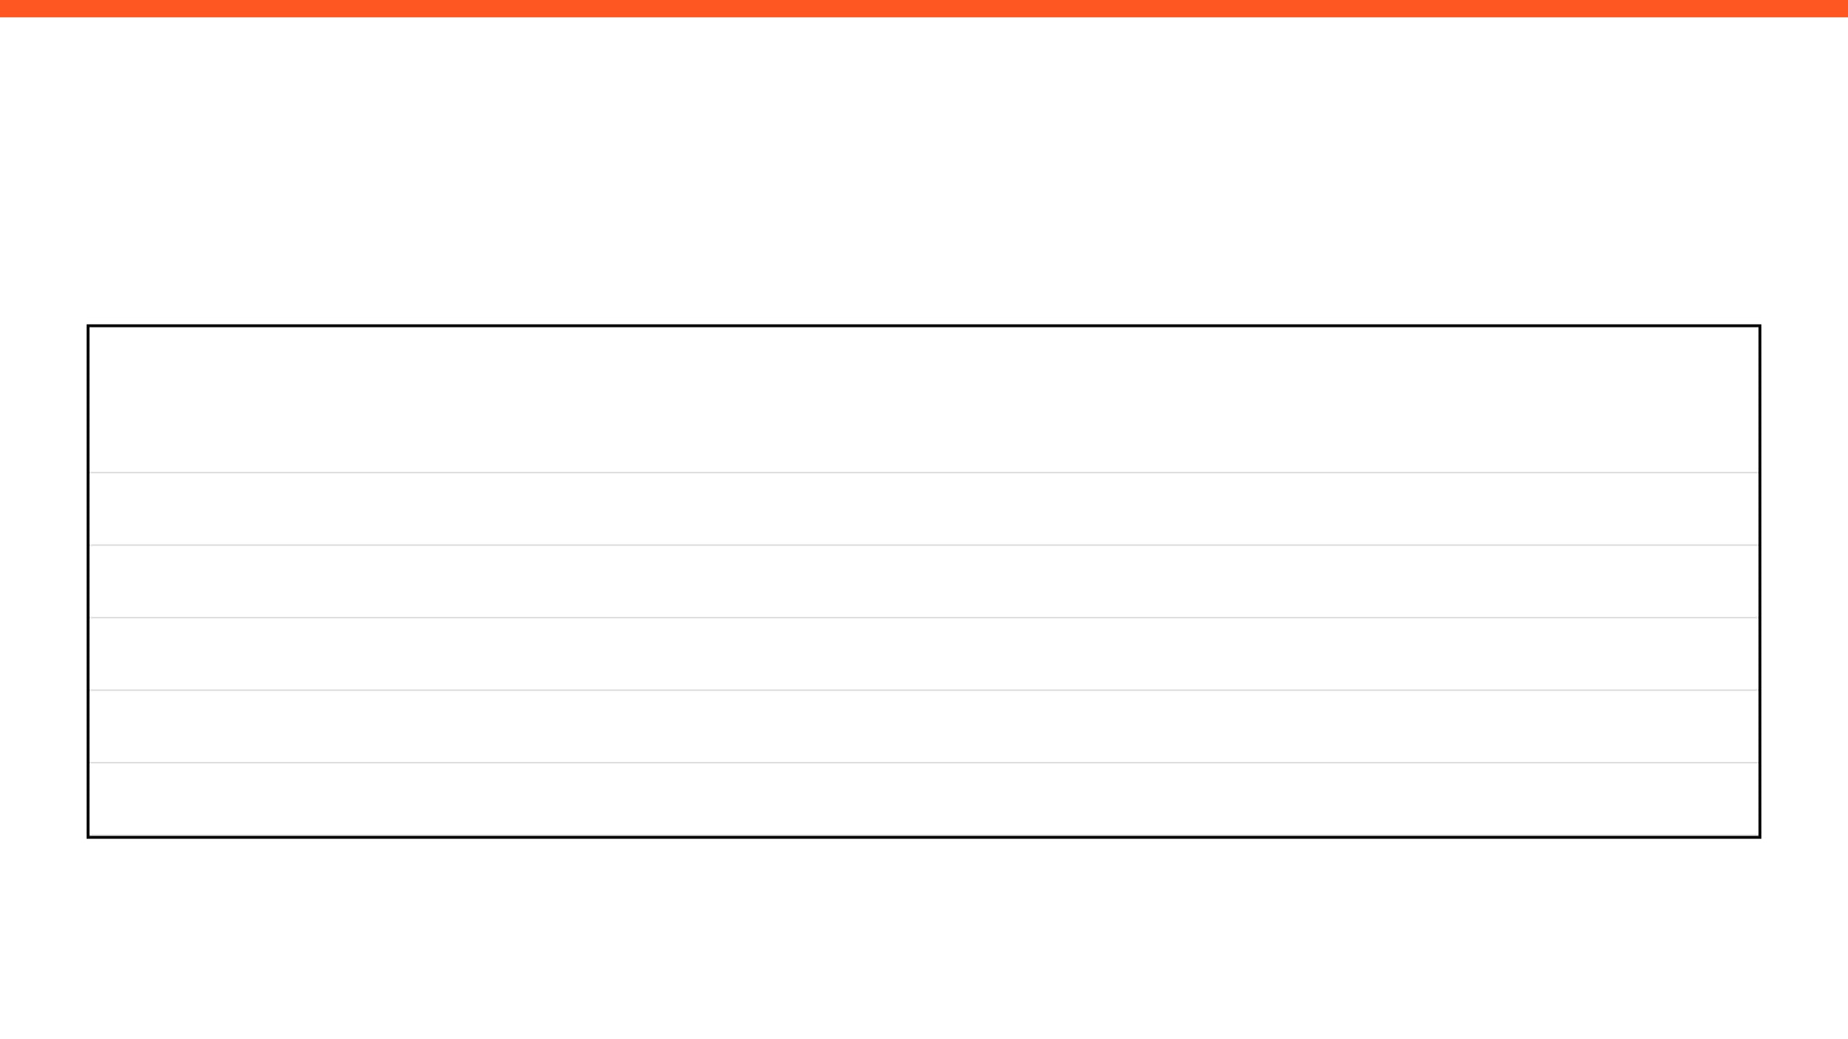

MILESTONES & DELIVERABLES

Slide 5
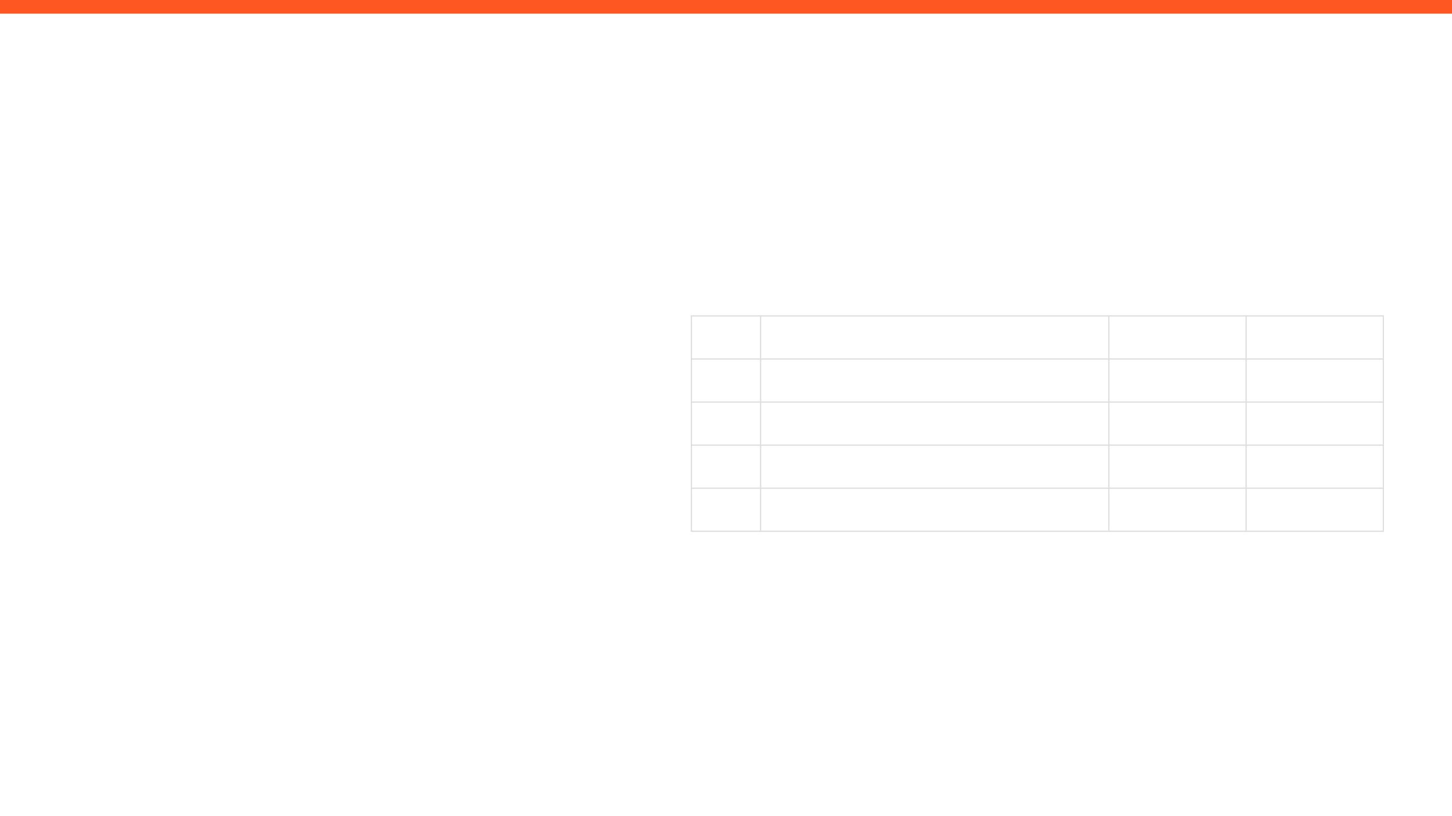
ISSUES, RISKS, AND ACTION ITEMS
TOP ISSUES (BLOCKING PROGRESS)
ACTION ITEMS (NEXT 7 DAYS)
•
Being limited to solely software-based work, ie: research/computer vision can slow
down performance – not having easy access to facilities to make the model, ie: 3D
printer.
ID
ACTION ITEM DESCRIPTION
MEMBER
WEEK DUE
A1
Investigate how to mitigate issues experienced using vision detection
Sabeeha
Week 4
•
Due to current circumstances, teammates cannot meet in person to discuss project
planning, this has resulted in Microsoft Teams meetings occurring 1-2 times a week.
This can be limiting as only one teammate has access to the objects that need to be
picked up by the arm.
Finalise the main CAD design and what is required in order to make the prototype.
A2
Maher
Week 4
A3
Investigate motion control strategy, torque estimations, suction system and gripper
Basel
Week 4
MITIGATIONS / DECISIONS NEEDED
A4
Finalise sensor selection and integration in system
Ahmad
Week 4
Focus on aspects that can be conducted without the need for printing the model
– design/computer vision/research
•
More comprehensive meetings are required to mitigate this issue,
planning in advance and strong delegation of tasks needs to be implemented.
•

Slide 6

INDIVIDUAL UPDATES
WEEKLY PROGRESS & NEXT STEPS
MEMBER 1
MEMBER 2
Maher Abo Abed
Sabeeha Zainab Hasham
MEMBER 3
MEMBER 4
Basel Feras Ghunaim
Ahmad Nasser Alshehhi

Slide 7
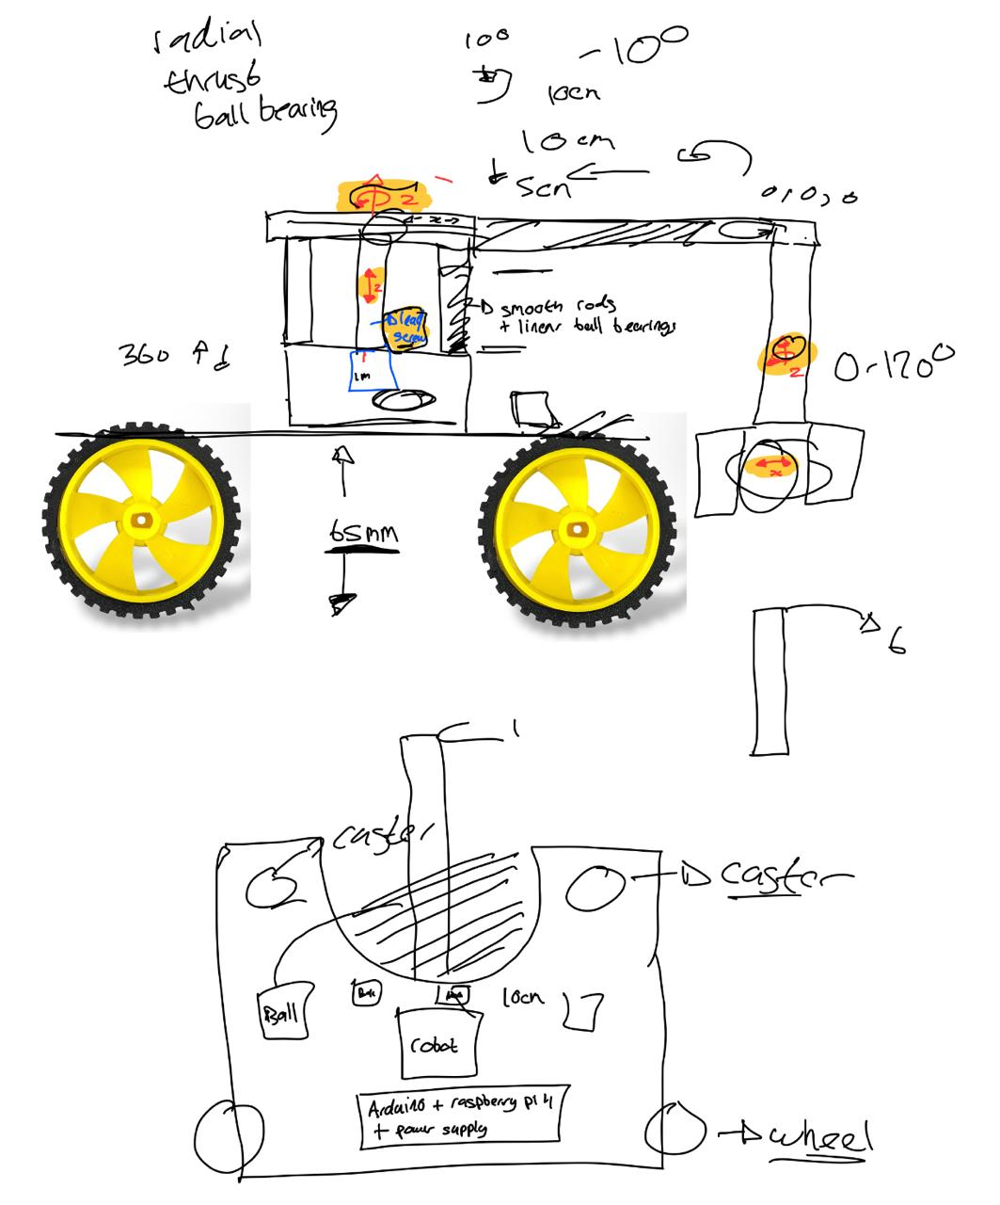
MEMBER 1: Maher Abo Abed
ACCOMPLISHED (SINCE LAST REPORT)
EVIDENCE
Design definition ( Joints, system architecture, environment planning, operation order)
System complexity reduction (Smart container placement,)
​​Started looking into the electrical architecture (Battery size, step down, motor drivers (A4989, PCA9685)​
Robots platform requirements (what components should there be space for?)​
Supporting components (Thrust, radial, ball bearing, flanges)
Joint mechanisms (lead screw, GT2 pulleys)
Explored existing designs
Sketches
IN PROGRESS
CAD Design
Exploring Open-Source frameworks
Research
Electrical Architecture
NEXT WEEK PLAN
Present a CAD design
Start fabrication
Procurement of components

Slide 8
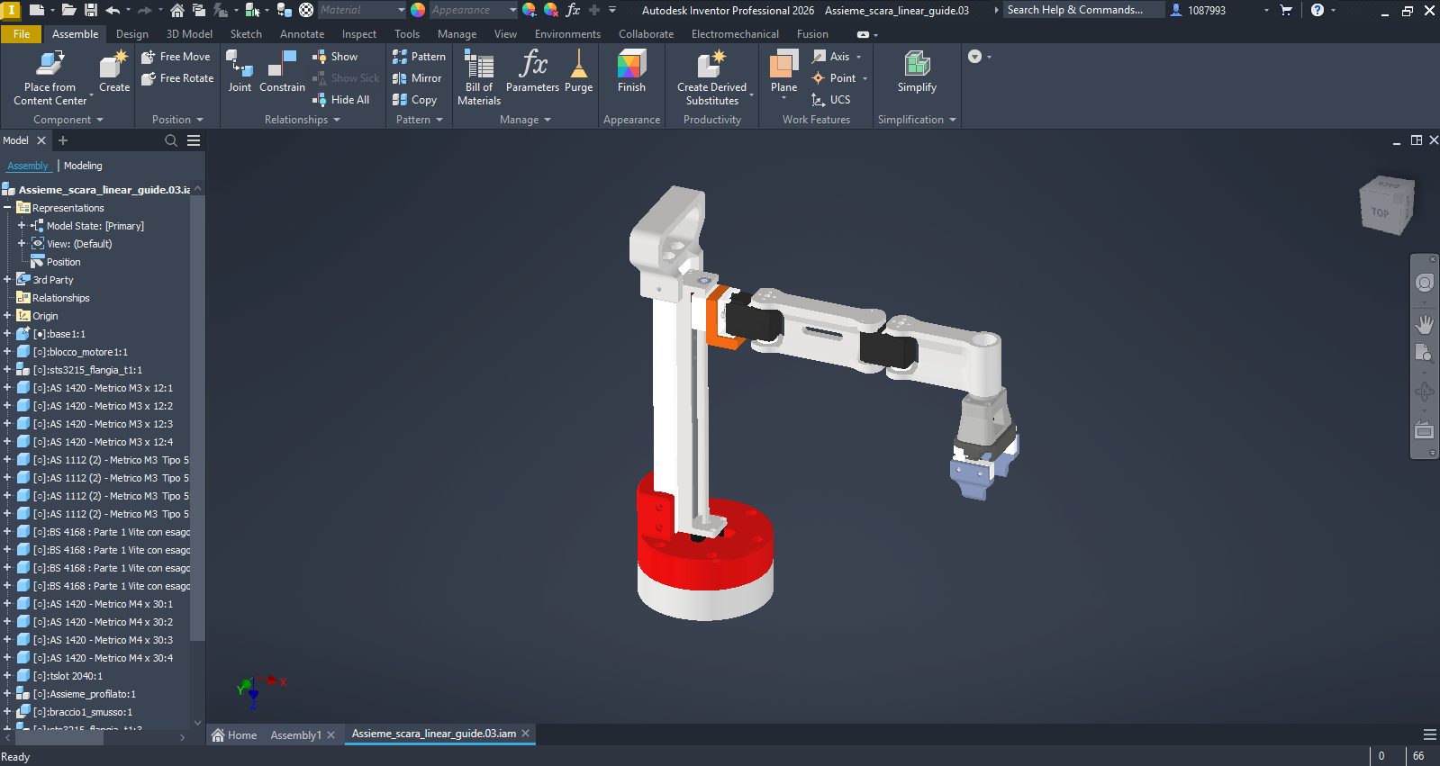
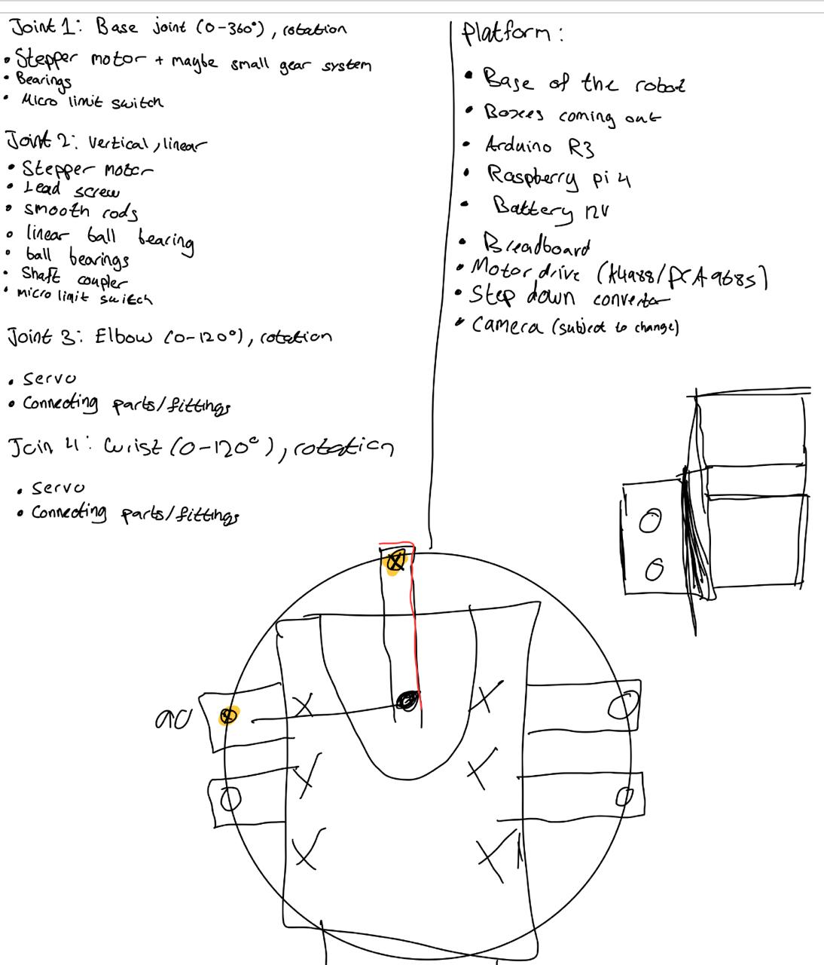
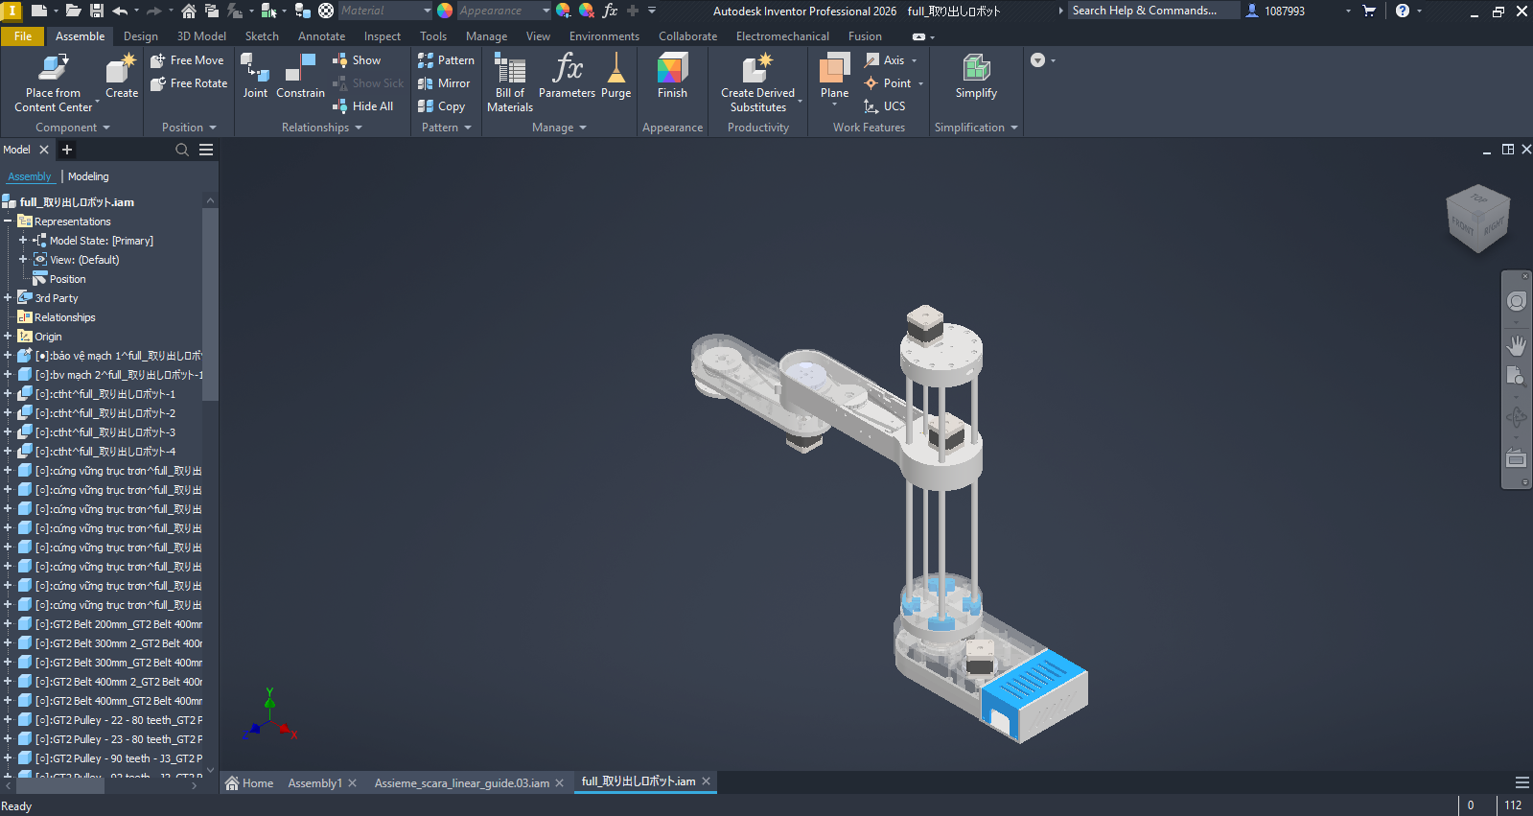

Slide 9
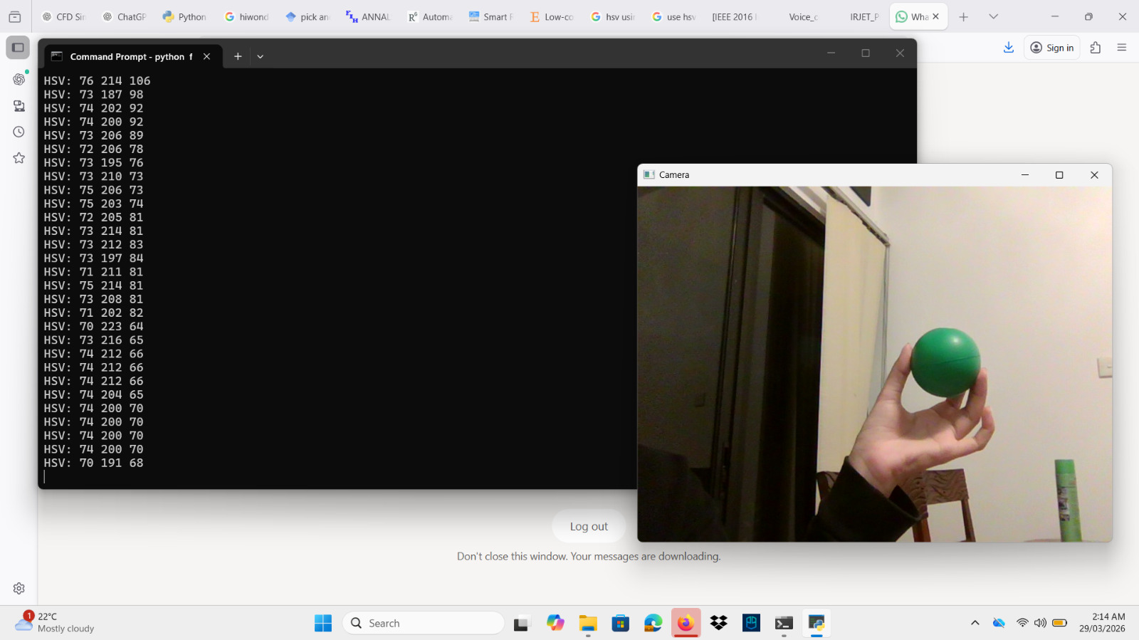
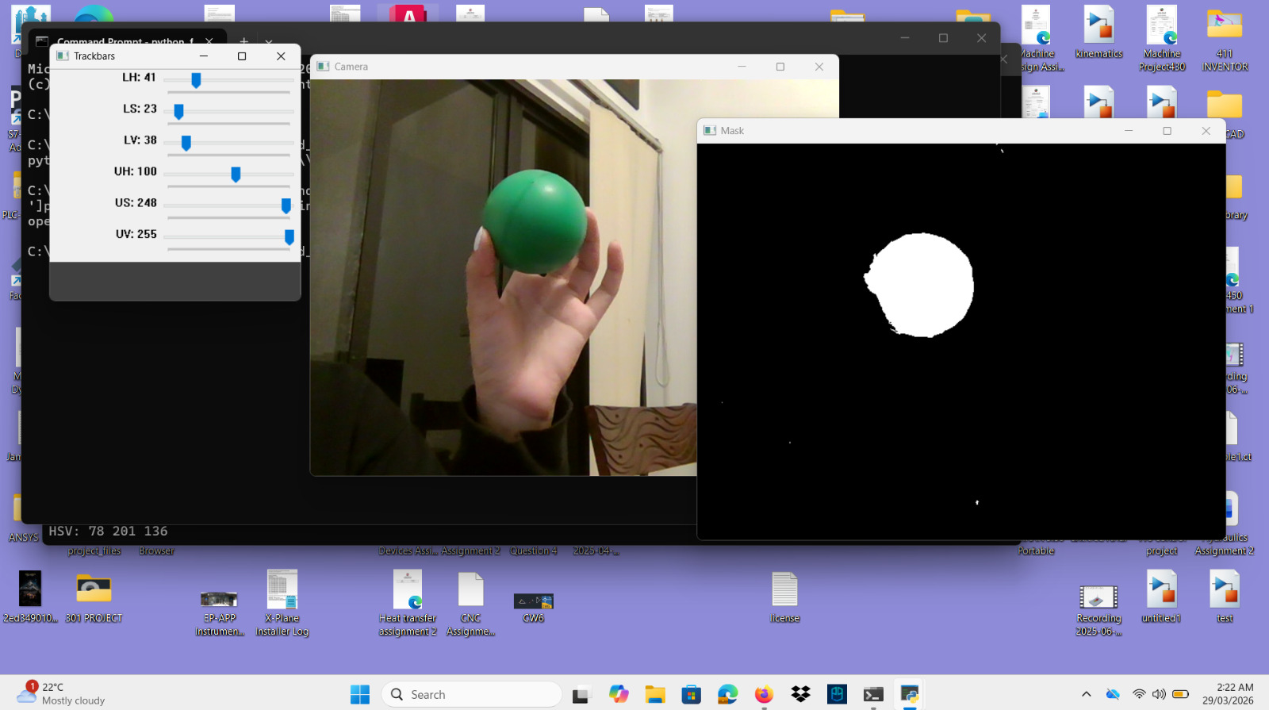
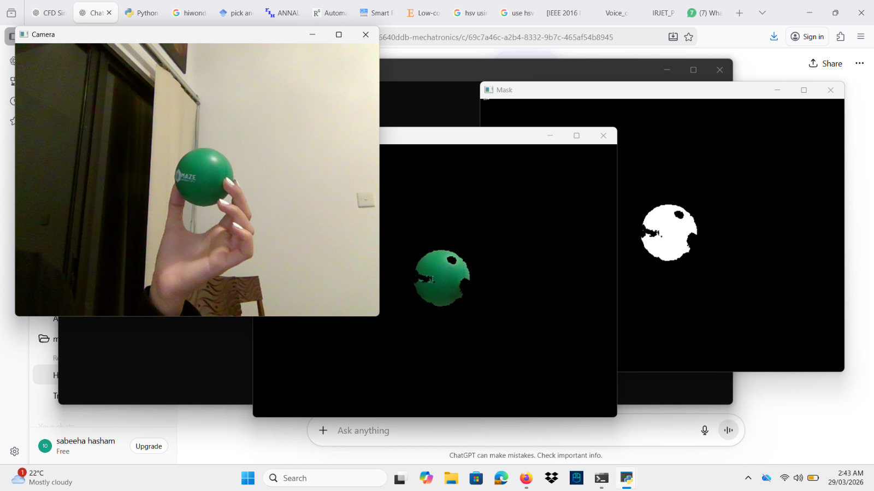
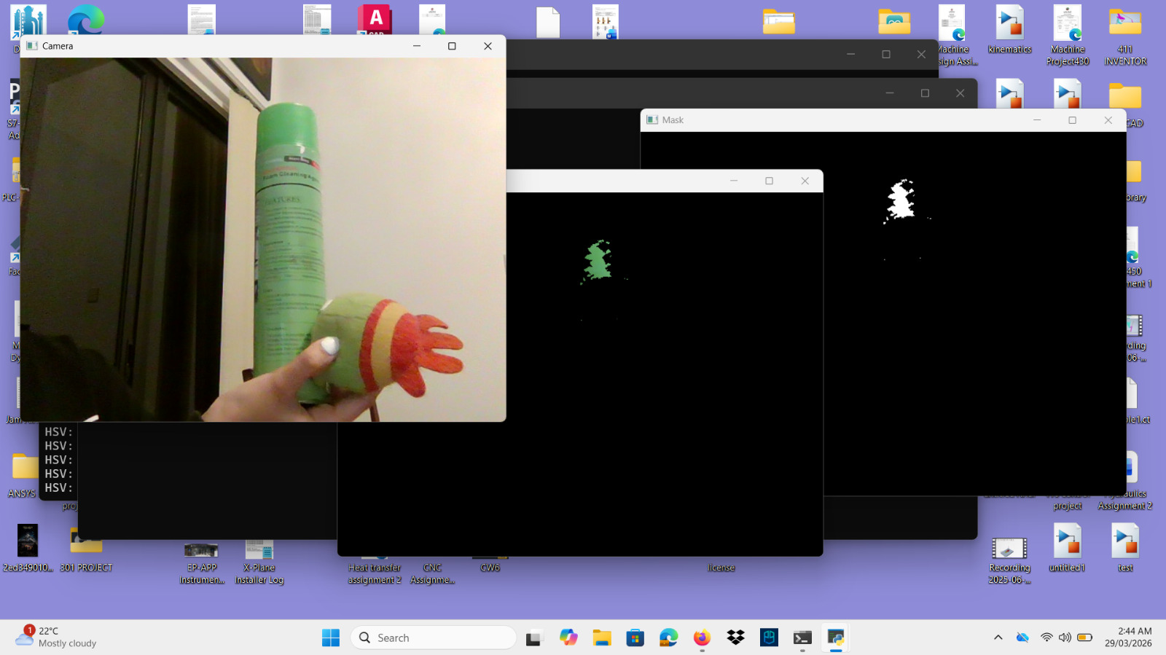
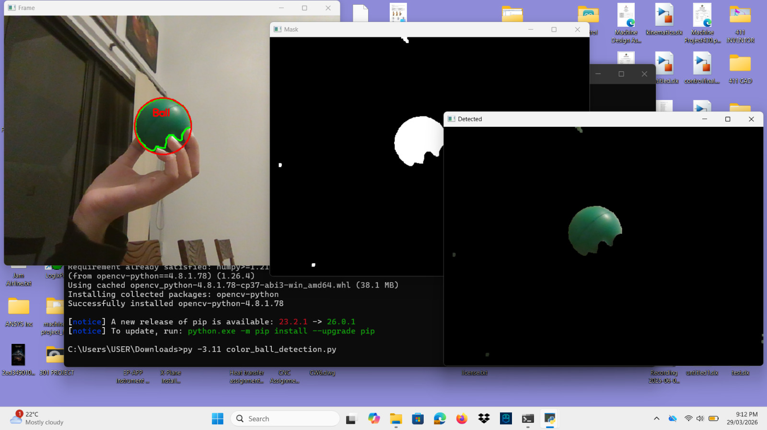
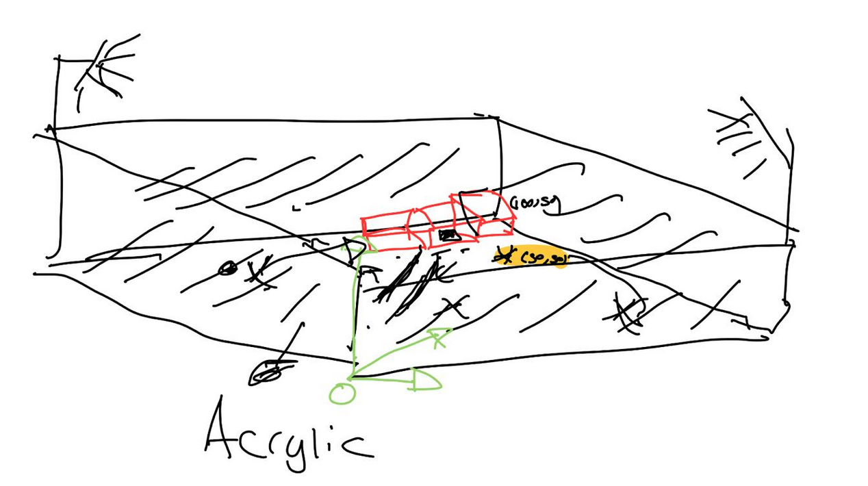
MEMBER 2: Sabeeha Hasham
EVIDENCE (SHOW, DON'T TELL)
ACCOMPLISHED (SINCE LAST REPORT)
Used opencv to implement colour detection to convert images from BGR to HSV and understanding the HSV colour space and how it can be further used.
Adjusted the threshold values to add ranges making it easier to isolate the object from its background, whilst testing shape detection as well.
Discussed CAD designs and how the setup will be implemented, the environment and layout of the project
•
•
IN PROGRESS
•
Trying to implement colour or shape detection on the bolt and nut, some obstacles have been run into due to the colour ranges of a metal being quite large and visual noise because of the background makes it hard to identify the object – it is important to take into consideration changing angles when in a pick and place robot.
•
NEXT WEEK PLAN
•
CAD design and shape detection refining.
HELP NEEDED / QUESTIONS
•
•

Slide 10
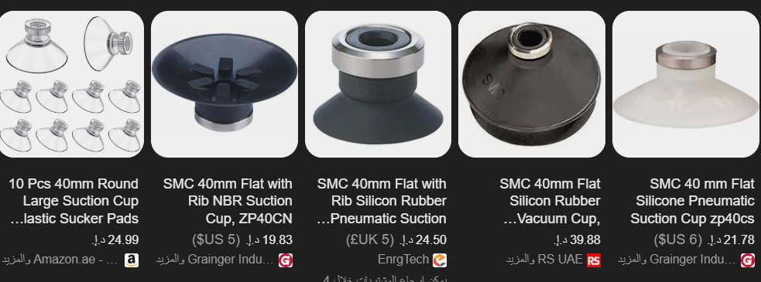
MEMBER 3: Basel Feras Ghunaim
ACCOMPLISHED (SINCE LAST REPORT)
IN PROGRESS
Completed evaluation of motion control strategies (AccelStepper vs custom step generation).
Finalized decision to use stepper motor step-counting with homing as the primary positioning method.
Conducted detailed analysis of encoder integration options (single encoder, dual encoder, and comparison with motor step tracking).
Refined hybrid end-effector concept (mechanical gripper + suction cup) and validated feasibility for all target objects.
Investigated vacuum pump specifications and confirmed suitability of electric vacuum pump over compressed air systems.
Implementing initial stepper motor control logic and testing basic motion behavior.
Evaluating potential positioning errors due to gear backlash and belt elasticity.
Optimizing suction cup placement and integration within the gripper design.
Reviewing control sequence timing for coordinated pick-and-place operations.
•
•
•
•
•
•
•
•
•
NEXT WEEK PLAN
•
•
•
•
•
•
•

Slide 11
MEMBER 4: Ahmed Alshehhi
ACCOMPLISHED (SINCE LAST REPORT)
IN PROGRESS
Reviewed research papers and technical resources on robotic gripper design.
• Selecting the most suitable gripper design based on object shape, weight, and fragility • Studying methods to control gripping force to ensure safe handling of delicate objects (e.g., egg)
•
•
Analyzed different gripper types (mechanical, soft grippers, and vacuum-based systems).
NEXT WEEK PLAN
HELP NEEDED / QUESTIONS
Finalize the gripper design and add it to the CAD model
•
•
Begin testing basic gripping concepts using a simple prototype
•

Slide 12
WRAP-UP: WHAT WE NEED FROM THE INSTRUCTOR / STAKEHOLDERS
DECISIONS REQUESTED
ACTION ITEMS FOLLOW-UP
Decide and work on the final the design.
Operating procedure
Electrical architecture
Software
Computer vision model strategy
• Begin initial CAD modeling and system integration
• Refine and finalise a vision detection and classification system to identify the objects
• Make final decisions on the workspace that the arm will operate in, everything related to size of workspace/colour, etc.
QUESTIONS / FEEDBACK
Can we create our own testing roles and conditions to suit our design?
Any updates with regards to coming back to the university?
APPENDIX
•
•

